Slide 1
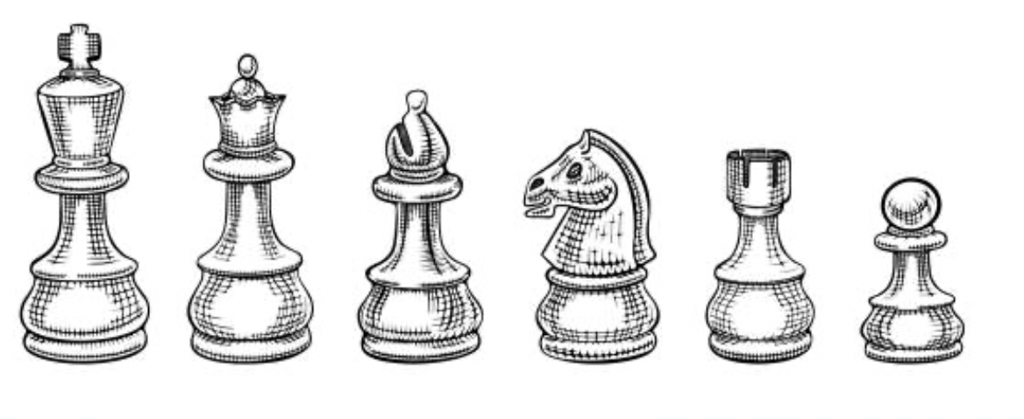
Distributed Quantum Computing
State of the Art, Challenges, and Open Horizons
The 5-minute blitz by María Gragera Garcés

Slide 2
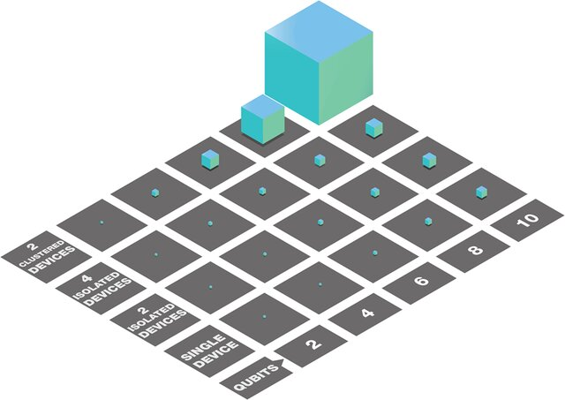
Why Distribute Quantum Computing?
arXiv:2002.11808

Slide 3
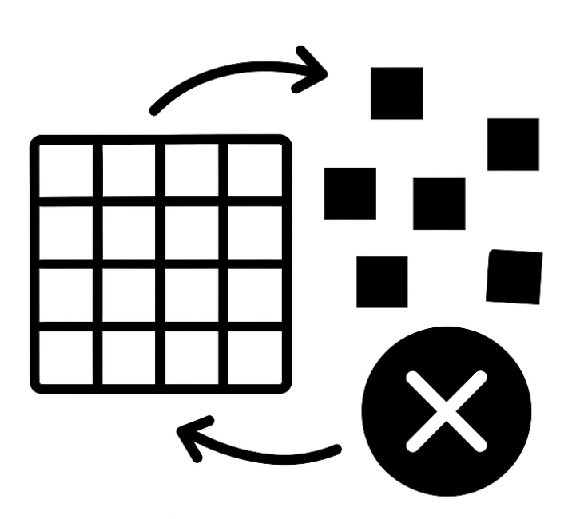
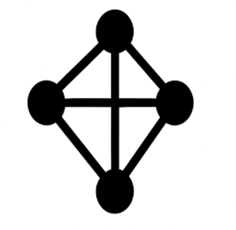


(some) Open Questions
Errors at scale: Should a distributed QPU act as one large logical code (e.g., qLDPC) or a patchwork of smaller codes (e.g., surface patches)? Global encoding efficiency V.S. modular control simplicity?
Network Composability: When quantum links are swapped for classical ones what are the intrinsic cost (fidelity, latency,…)?
Architectural Parallelism: Will we see speedups from quantum parallelism imposed by the network, and not by algorithms – akin to their classical counterparts?
Algorithm design: How can we efficiently design and/or compile distributable algorithms at scale?

Slide 4
Four Levels of Distribution
Problems
Algorithms
Subroutines
Models
4 possible answers to:
Algorithm design: How can we efficiently design and/or compile distributable algorithms at scale?

Slide 5
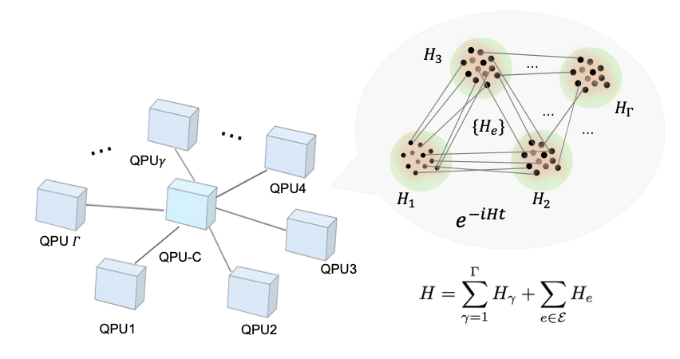
Four Levels of Distribution
Problems
Algorithms
Subroutines
Models
Problems
Hamiltonian simulation
Unstructured Search
Optimization
Hiden Subgroup (HSP)
Linear equations
etc
Solutions
arXiv: 2411.02881

Slide 6
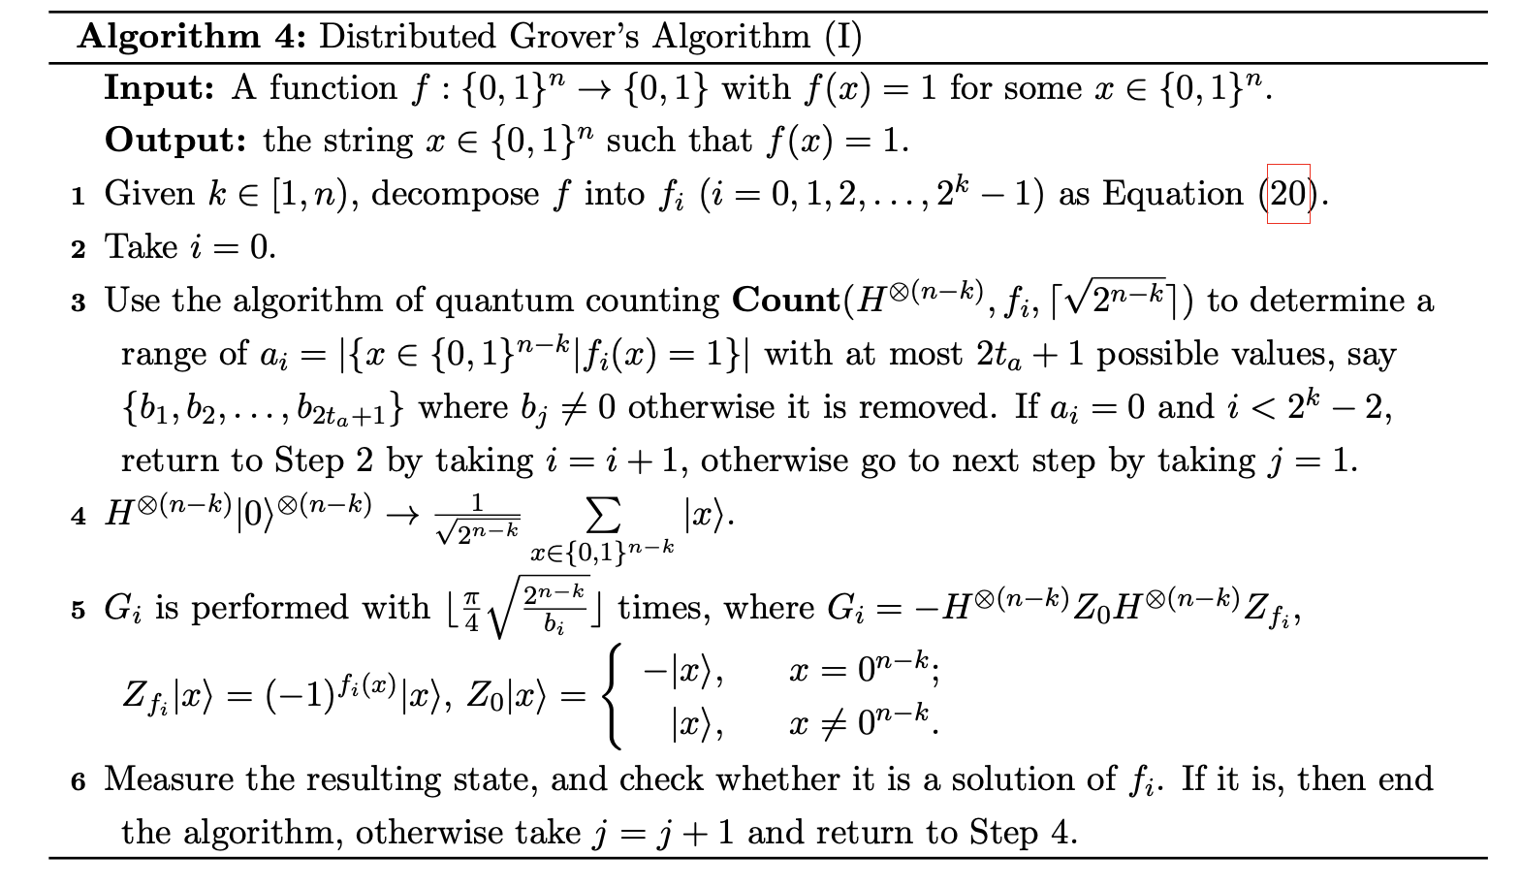
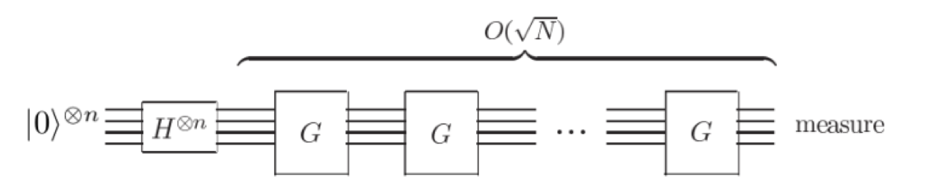
Four Levels of Distribution
Problems
Algorithms
Subroutines
Models
Algorithms
Element distinctness
Grovers’
HHL
QAOA
Shors’
Simons’
Spatial Search
Trotterization
etc
Solutions
arXiv: 2204.10487

Slide 7
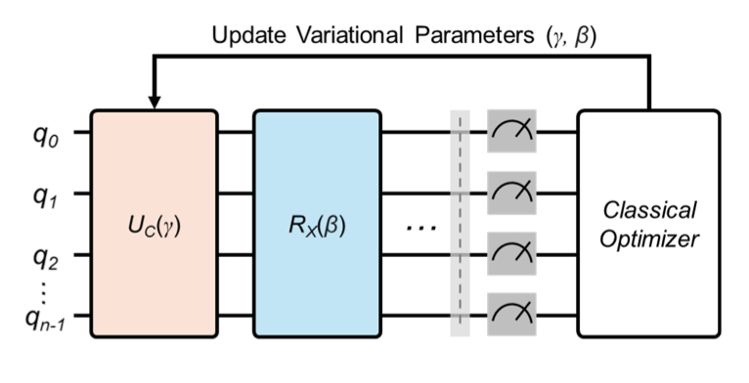
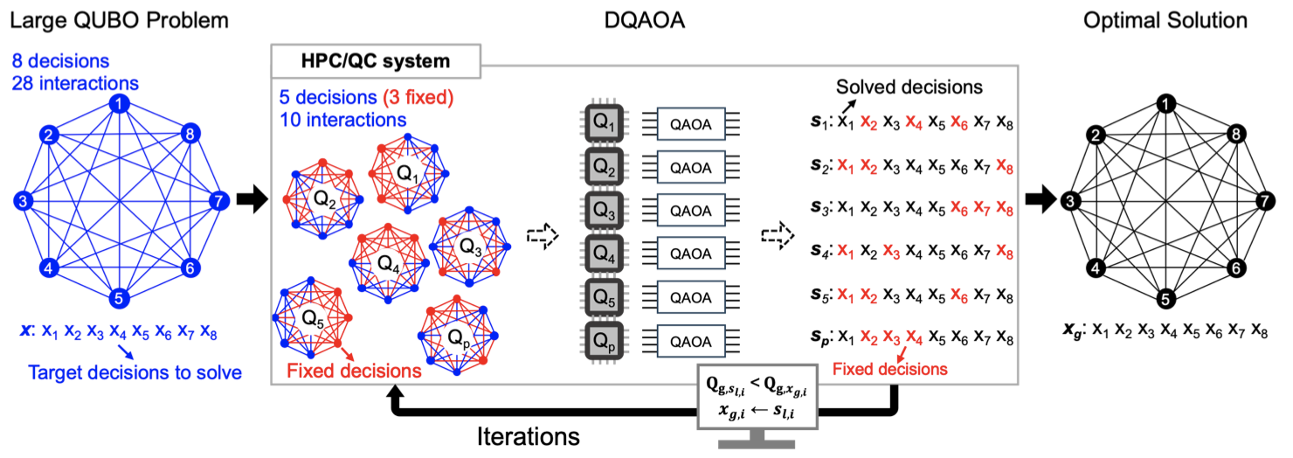
Four Levels of Distribution
Problems
Algorithms
Subroutines
Models
Subroutines
Amplitude estimation
Mixing ansätze
Oracles
Phase Estimation
QFT
Sampling
State prep
VQE
etc
Solutions
arXiv: 2407.20212

Slide 8
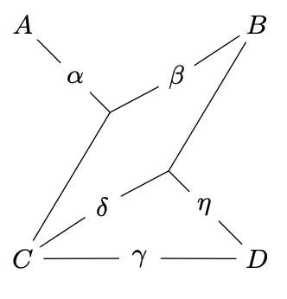
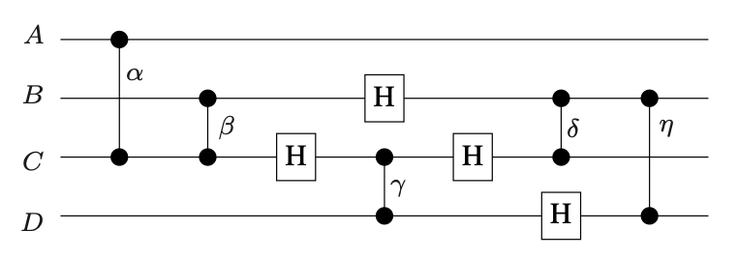
Four Levels of Distribution
Problems
Algorithms
Subroutines
Models
Models
Circuits
MBQC
Quantum Walks
Topological
Adiabatic
Boson Sampling
etc
Solutions
Hypergraph partitioning
arXiv: 1811.10972

Slide 9
Thank you!
State of the Art, Challenges, and Open Horizons
The 5-minute blitz by María Gragera Garcés

